Slide 1
Data acquisition and wrangling
Name : Rutuja Gawas
Organization Name: NextHikes IT Solutions
Project Name: Data acquisition and wrangling

Slide 2
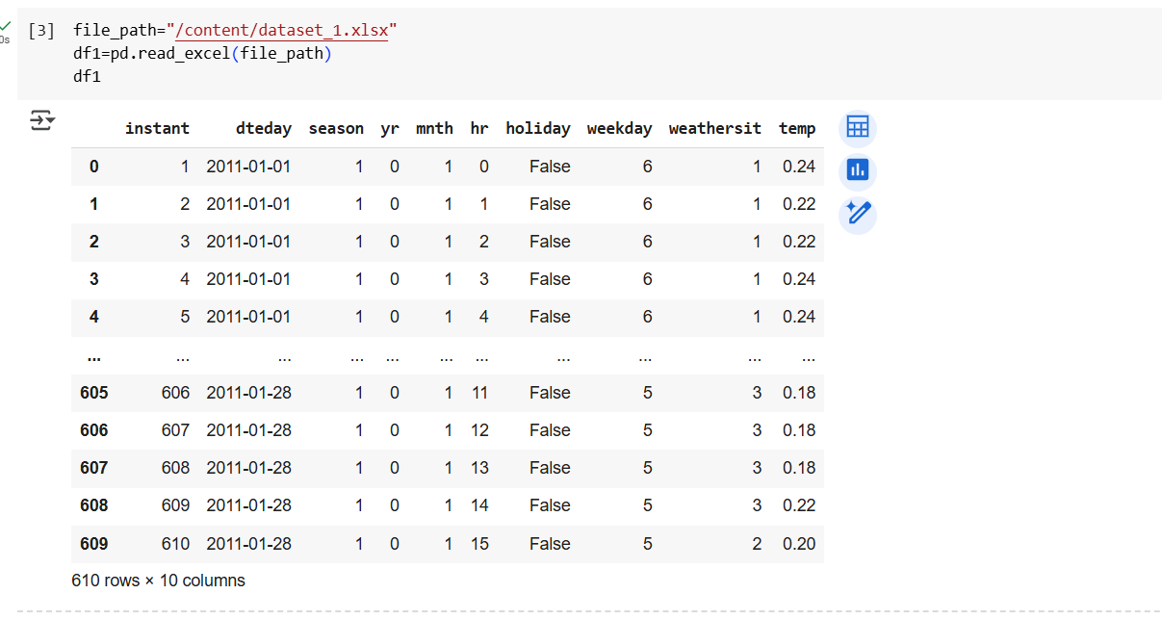
#UPLOADED DATASET1

Slide 3
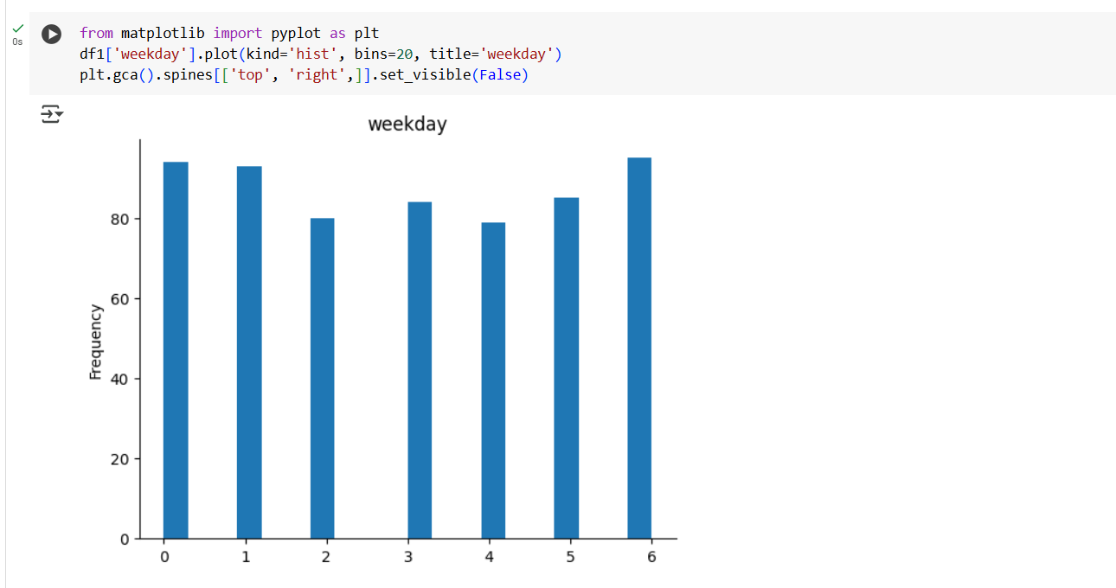
#CHART#DATASET 1

Slide 4
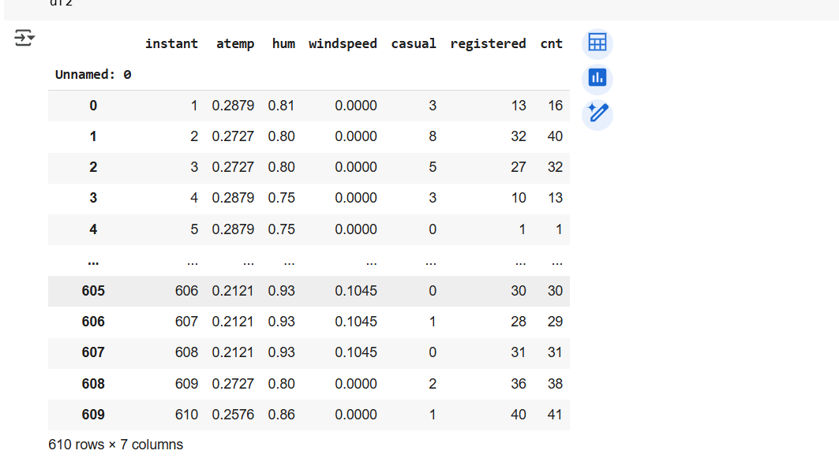
#UPLOADED DATASET2

Slide 5
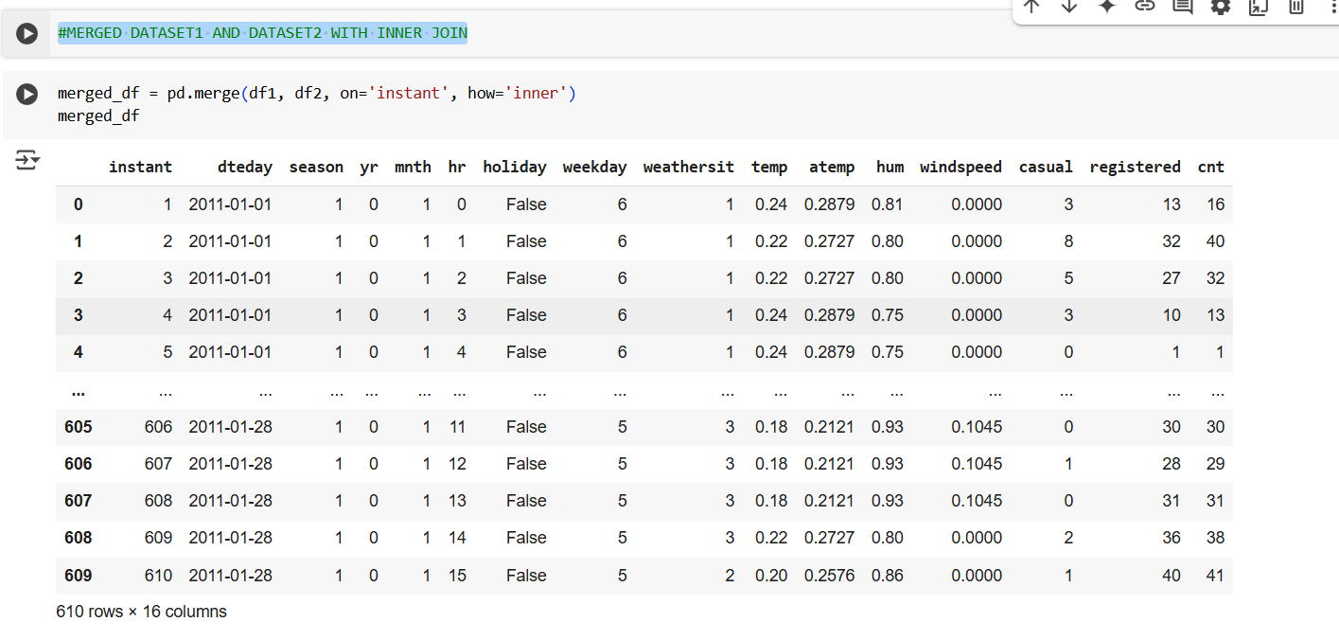
# #MERGED DATASET1 AND DATASET2 WITH INNER JOIN

Slide 6
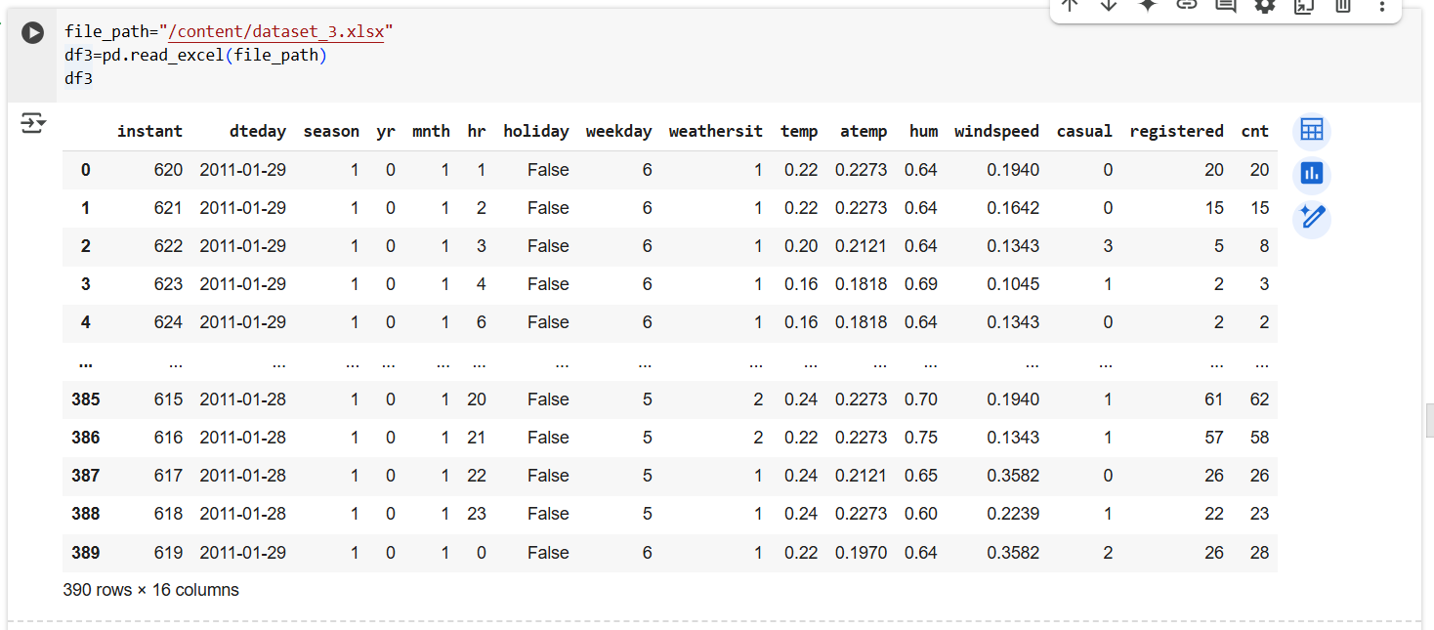
#UPLOADED DATASET 3

Slide 7
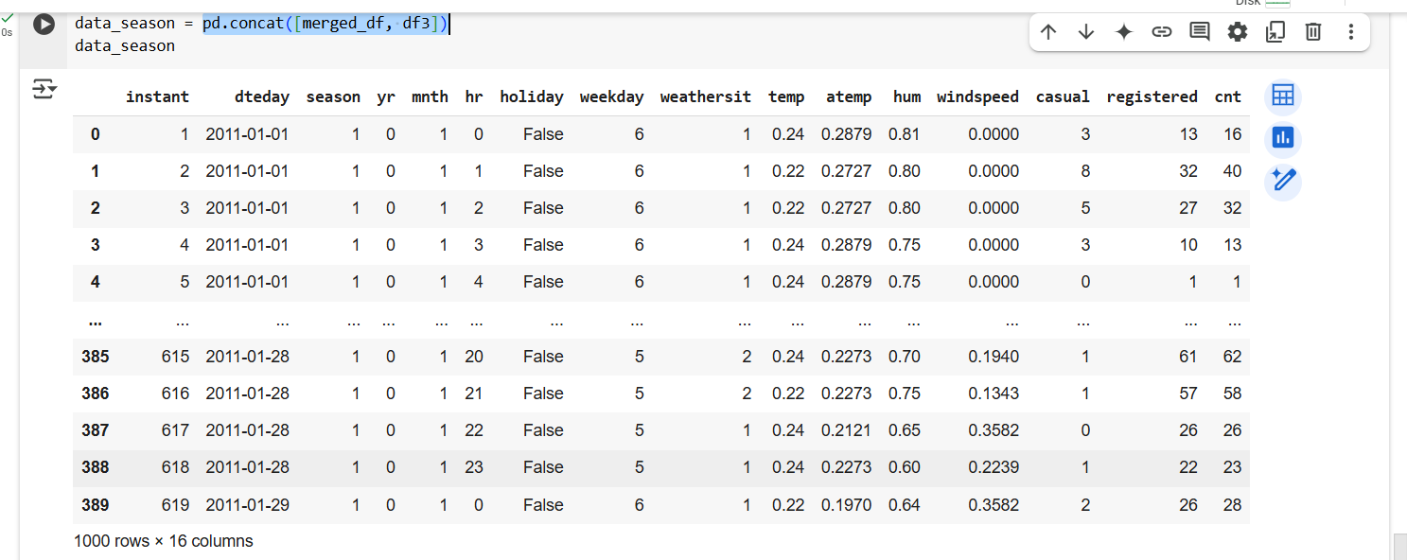
pd.concat([merged_df, df3])

Slide 8
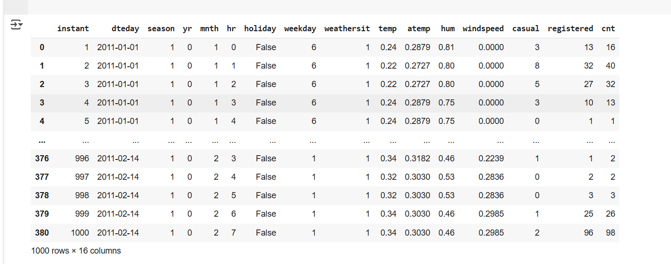
data_season=data_season.sort_values(by='instant')

Slide 9
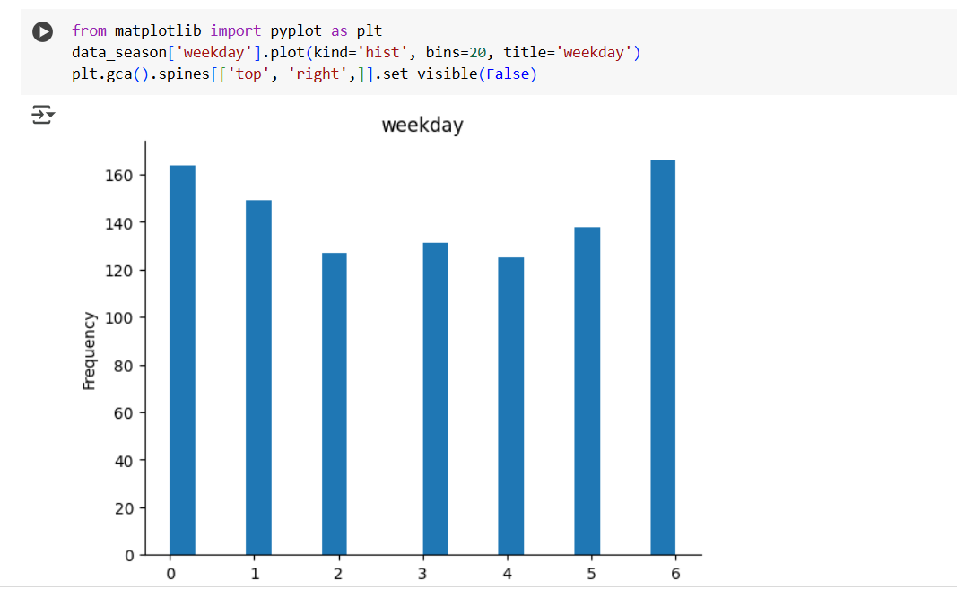
#CHART#COMBINE_ALL DATASET

Slide 10

data_season=data_season.sort_values(by='instant')

